Slide 1


Slide 2

Hypothesis tests -paired t-tests with small samples
In Section 9.2, we have looked at the difference in population means in the “unpaired test”.
Consider a situation where we need to measure the effect of a variable on a set of data, then we measure twice: before the change in variable, and after. This repeated measures design allows us to pair the points in the two datasets. In this situation, a paired t-test would be the most appropriate test to perform.
In a paired test, the same set of samples is tested in two conditions.
In a paired t-test, instead of measuring the difference in the means, we measure the mean of the differences, as shown in the Key point 9.7.

Slide 3
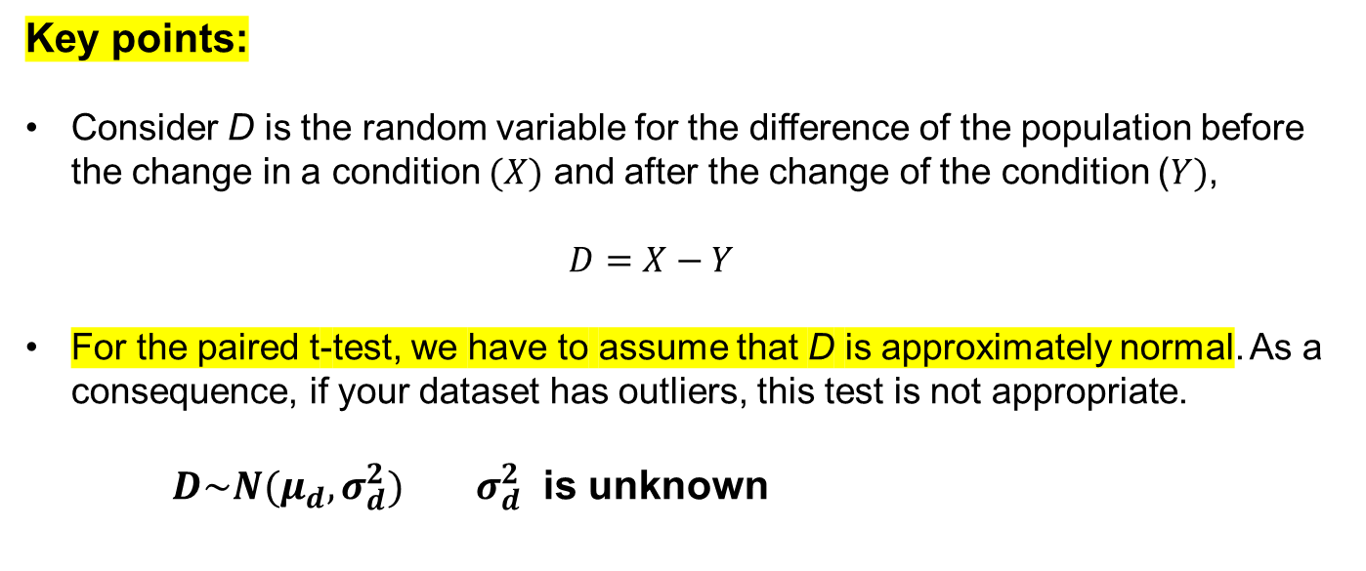
Key points:
Consider D is the random variable for the difference of the population before the change in a condition $(X)$ and after the change of the condition ($Y)$,
$$D=X−Y$$
For the paired t-test, we have to assume that D is approximately normal. As a consequence, if your dataset has outliers, this test is not appropriate.
$D\sim N(μ_{d}, σ_{d}^{2})$ $σ_{d}^{2}$ is unknown

Slide 4
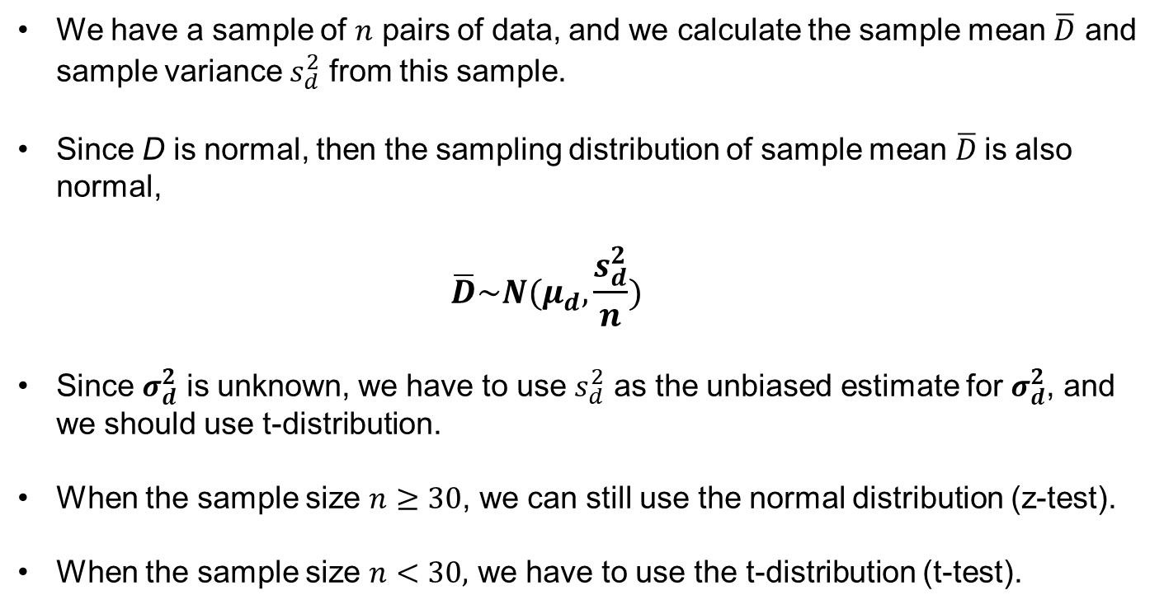
We have a sample of $n$ pairs of data, and we calculate the sample mean $\overline{D}$ and sample variance $s_{d}^{2}$ from this sample.
Since D is normal, then the sampling distribution of sample mean $\overline{D}$is also normal,
$$\overline{D}\sim N(μ_{d},\frac{s_{d}^{2}}{n})$$
Since $σ_{d}^{2}$ is unknown, we have to use $s_{d}^{2}$ as the unbiased estimate for $σ_{d}^{2}$, and we should use t-distribution.
When the sample size $n≥30$, we can still use the normal distribution (z-test).
When the sample size $n<30,$ we have to use the t-distribution (t-test).

Slide 5
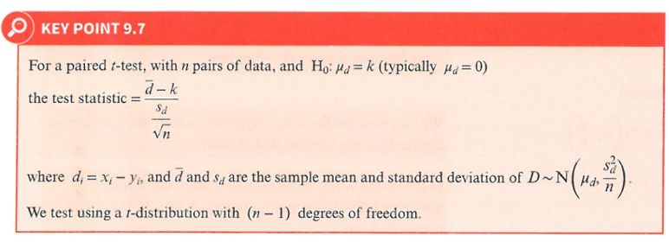

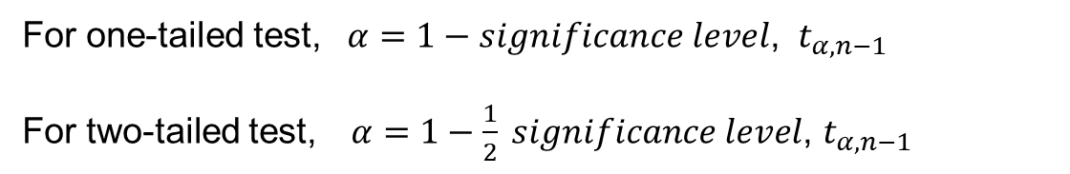


$$t_{α,n−1}=\frac{\overline{d}−μ_{d}}{\frac{s_{d}}{\sqrt{n}}}$$
wrong, should be
$\overline{D}\sim N(μ_{d},\frac{s_{d}^{2}}{n})$
Note： in this situation, the sample size is small ($n<30)$, so we are using the t-distribution (t-test).
For one-tailed test, $α=1−significance level$, $t_{α,n−1}$
For two-tailed test, $α=1−\frac{1}{2} significance level$, $t_{α,n−1}$

Slide 6
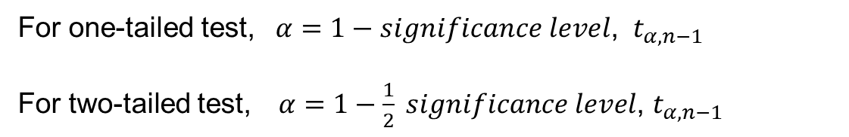
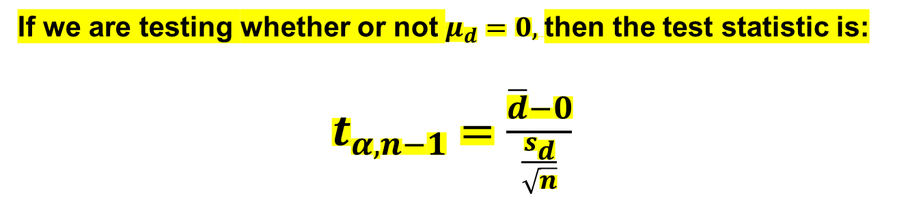
If we are testing whether or not $μ_{d}=0,$then the test statistic is:
$t_{α,n−1}=\frac{\overline{d}−0}{\frac{s_{d}}{\sqrt{n}}}$
For one-tailed test, $α=1−significance level$, $t_{α,n−1}$
For two-tailed test, $α=1−\frac{1}{2} significance level$, $t_{α,n−1}$

Slide 7
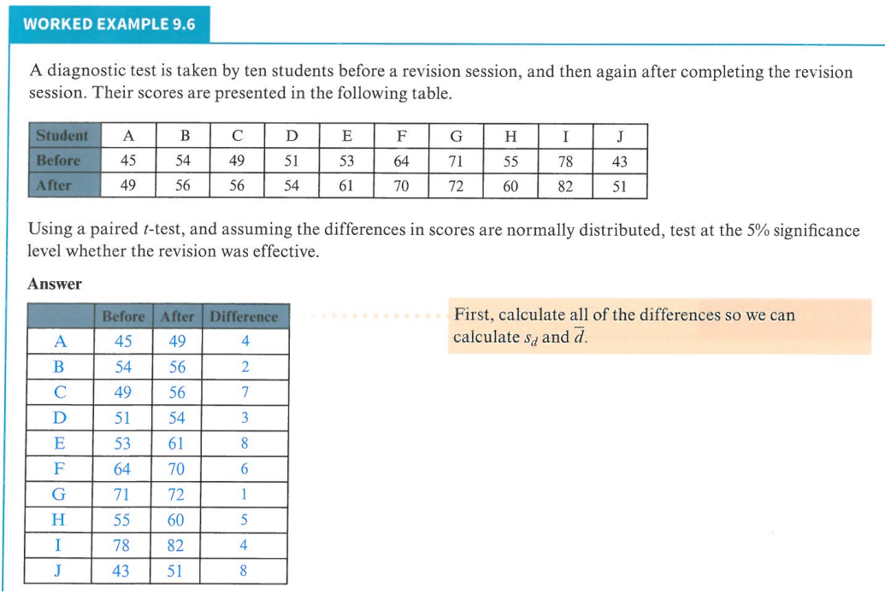
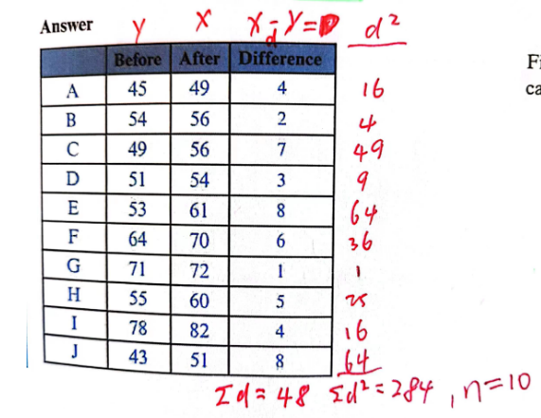

$$n=10<30$$

Slide 8
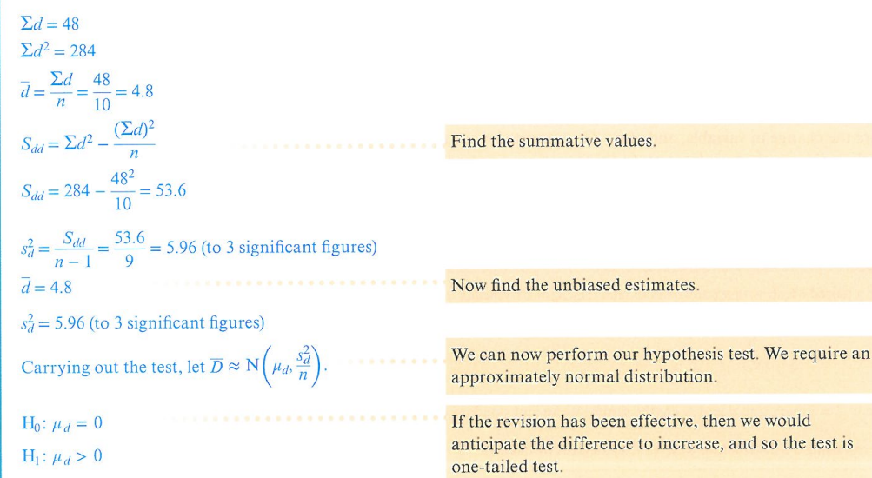

Slide 9
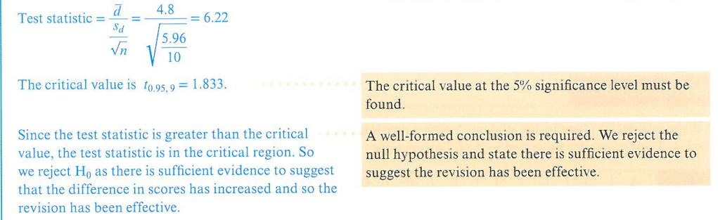
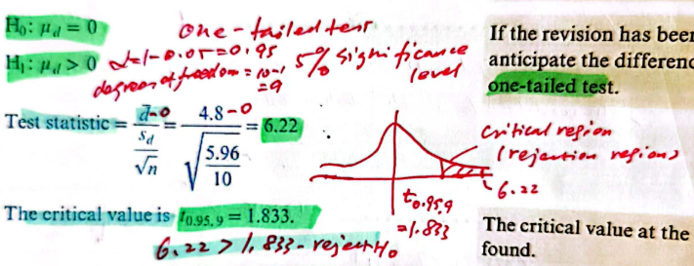

Slide 10
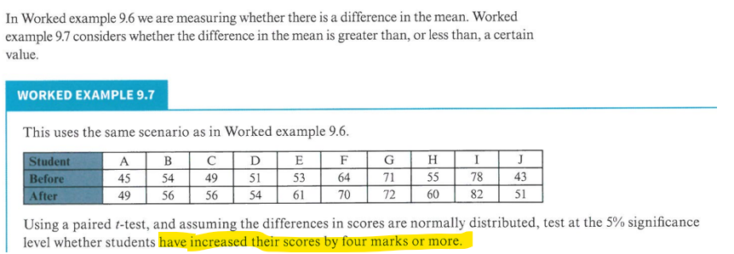

Slide 11
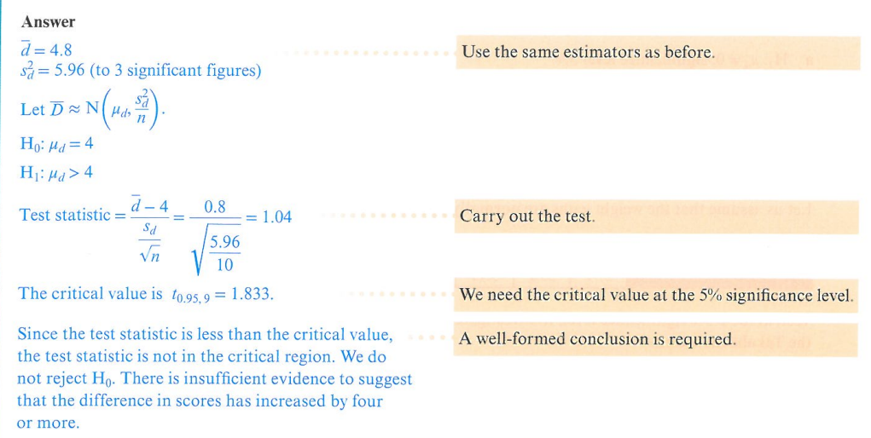
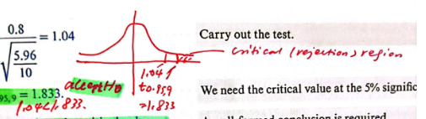

We accept $H_{0}$
Combine the results of the two examples, the overall conclusion is: although the revision has been effective, but it is not effective enough to increase the scores by 4 marks or more, on average.

Slide 12
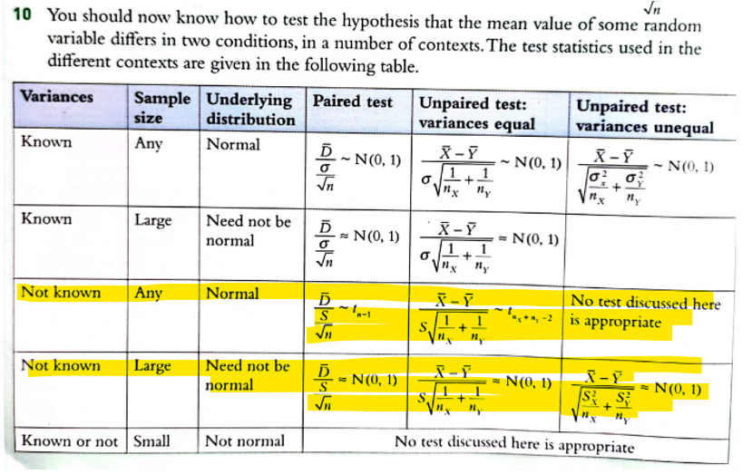

Slide 13
Practice Time!

Slide 14
Exercise 9C
In class 1,2,3,4
Homework 5,6,7

Slide 15
The End
Thank You

